Slide 1
Hydrogenation Work Tracker V0.01

Slide 2
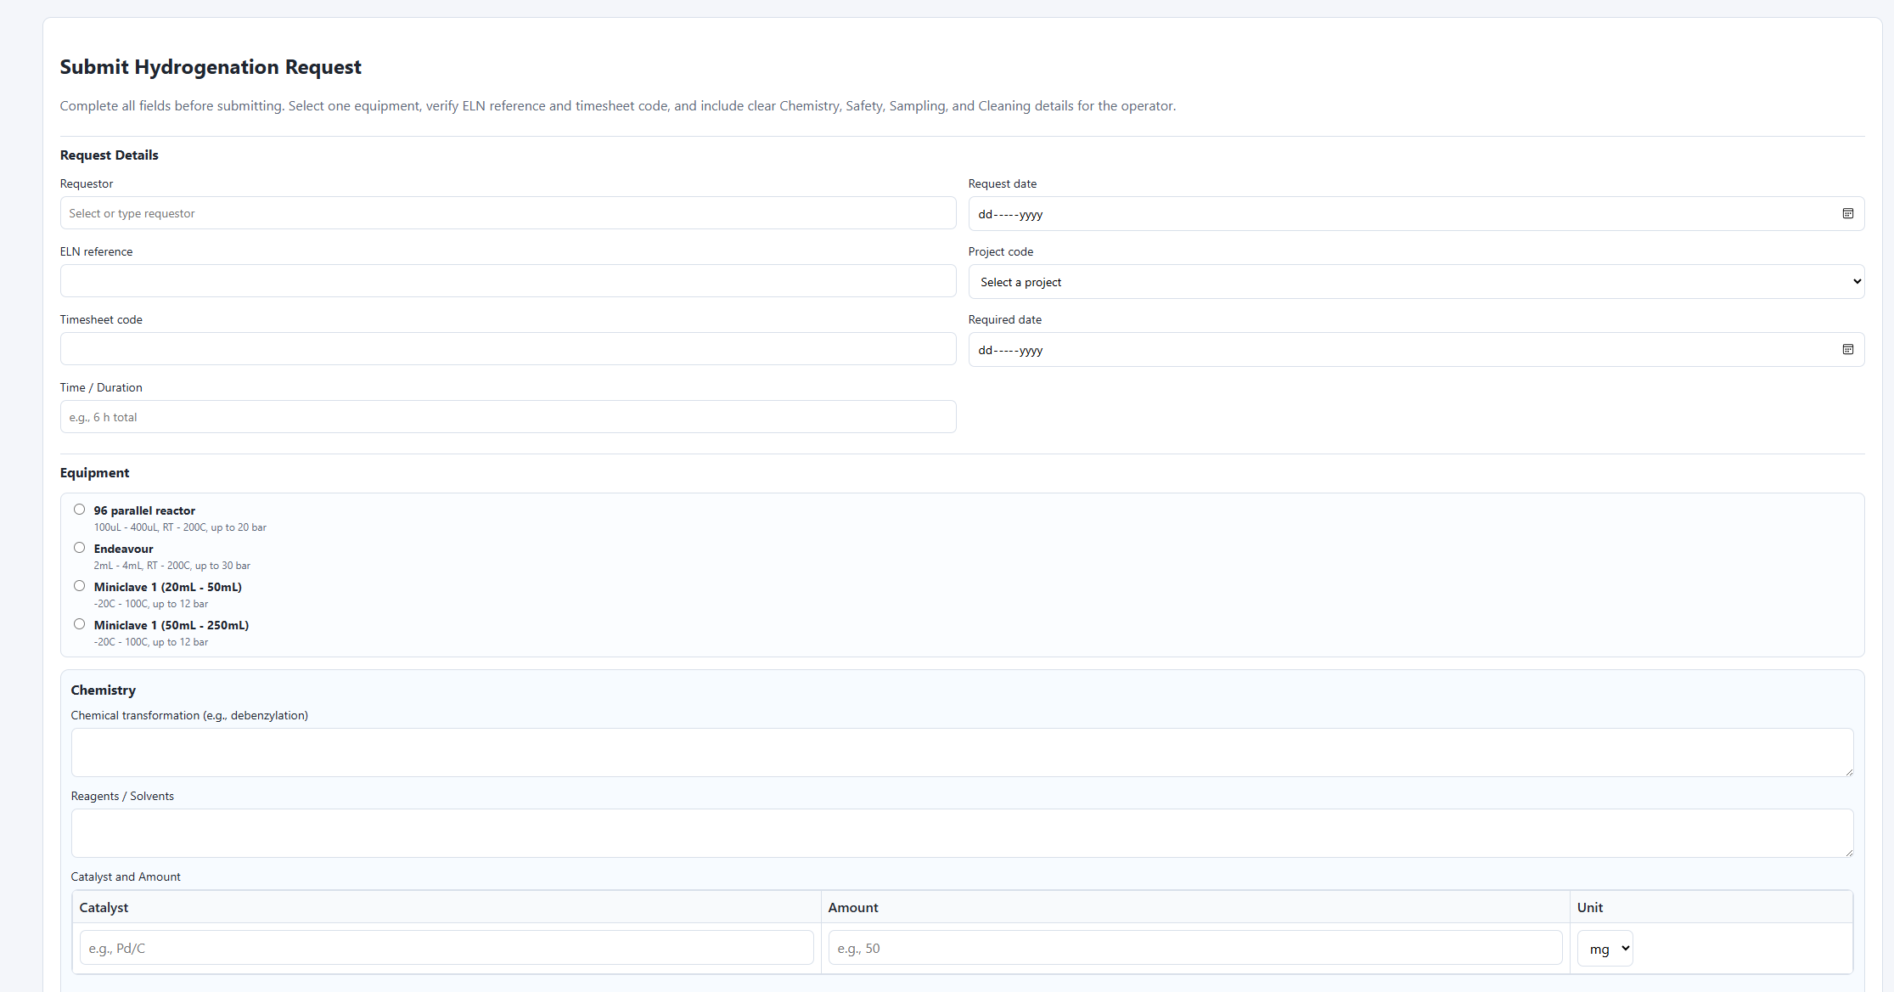
Access
Submit Hydrogenation Request
Brings to below landing page – populate all fields even if N/A

Slide 3
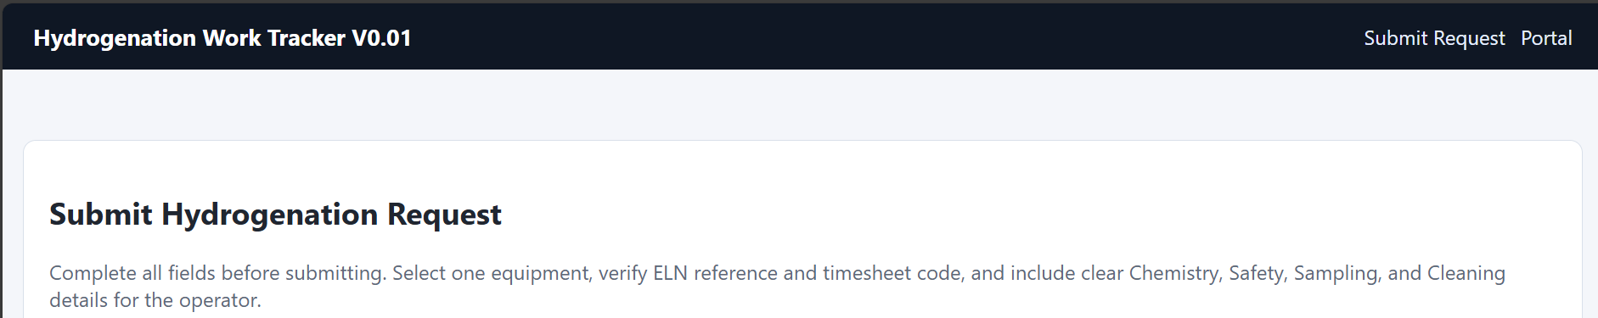
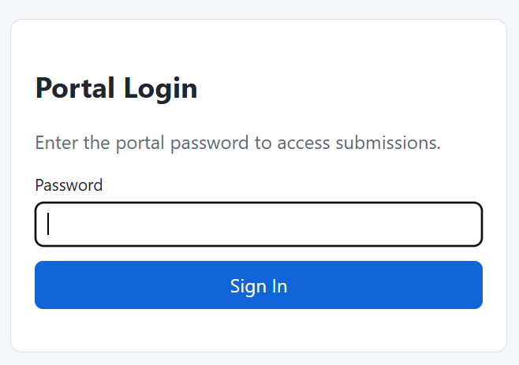
Management
Click portal
Password - LotsOfBubbles

Slide 4
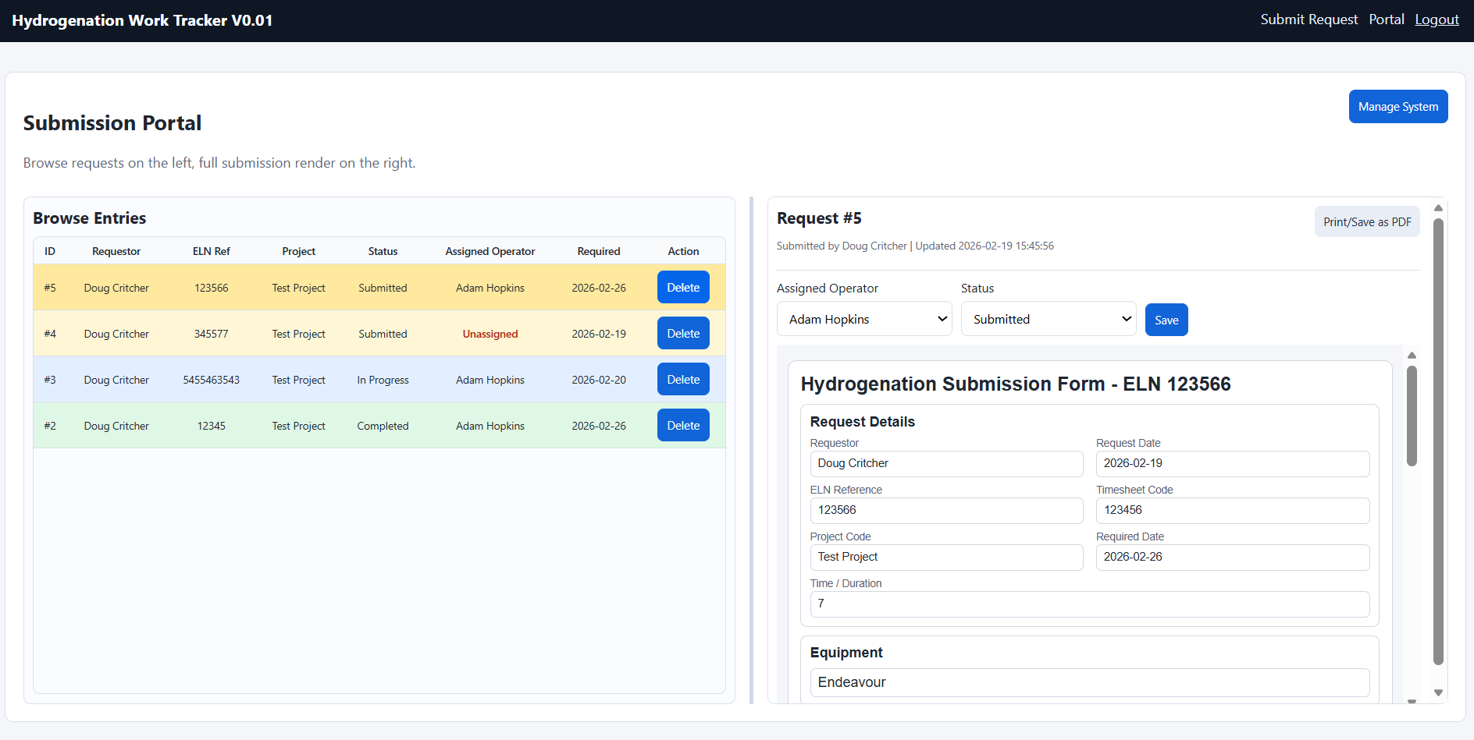
Manage Users, Projects and Equipment
Assign Operator and Status. Also view/print submission form
Browse submissions

Slide 5
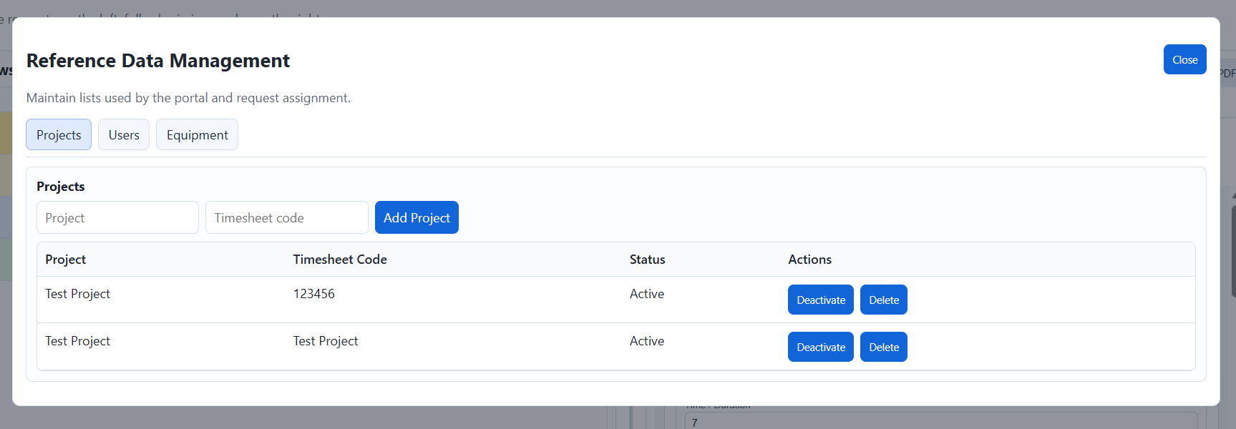
In manage, it is possible to add project, users and equipment. As well as activate and deactivate them.
They must be added here in order for users to be able to select them on the submission form

Slide 6
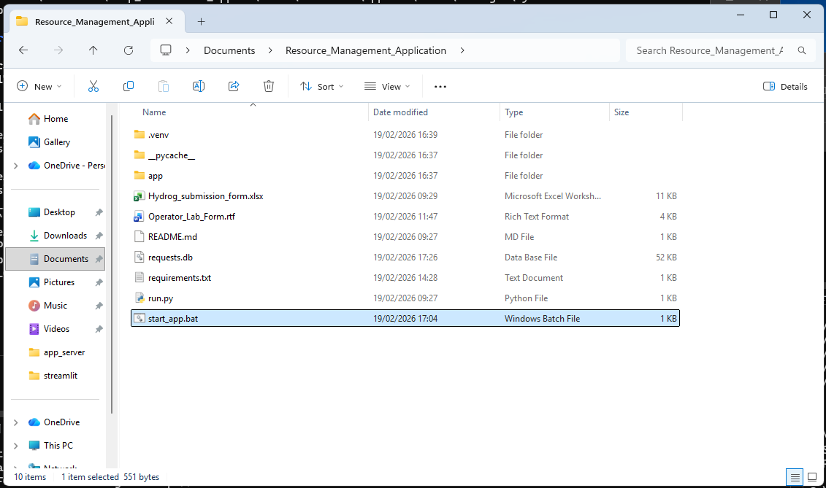

Re-starting the app (Should be running already)
C:\Users\crduser01\Documents\Resource_Management_Application
Set password when running .bat

